Slide 1
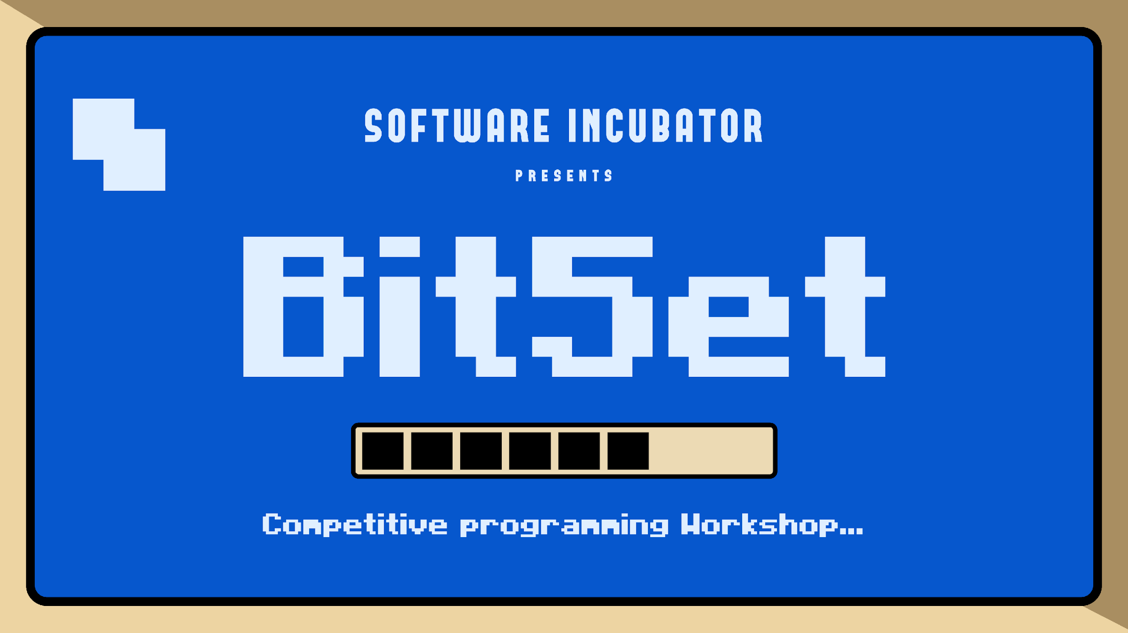

Slide 2
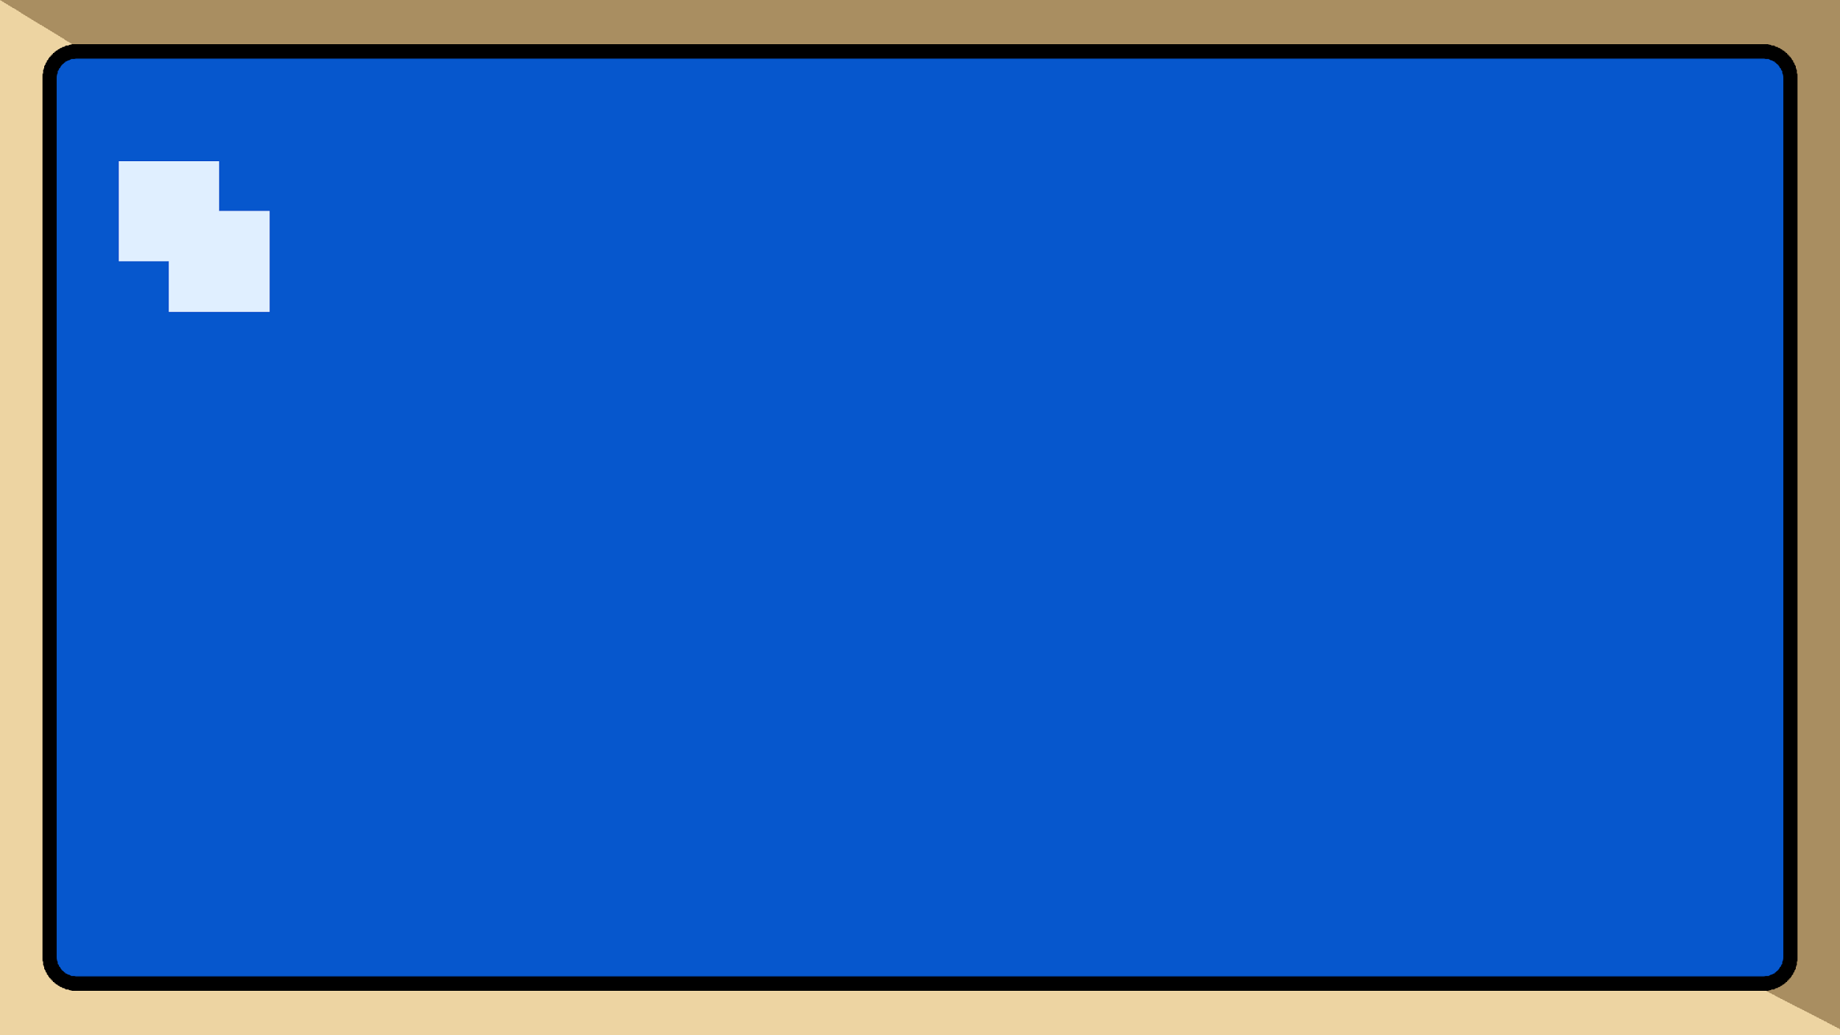
SORTING

Slide 3

SORTING
Data sorting is any process that involves arranging the data into some meaningful order.We generally sort the array in ascending or descending order.
Examples of sorting:-
A = {1, 6, 4, 3, 3, 2, 7}
A = {1, 2, 3, 3, 4, 6, 7} -- sorted in ascending
A = {7, 6, 4, 3, 3, 2, 1} -- sorted in descending
01

Slide 4
Sorting in Competitive Programming
Sort STL :- a[n]
sort(a, a+n); → ascending order
sort(a, a+n, greater<int>()); → descending order
What sorting algorithm is used?
Combination of following three algorithms:
Quicksort, Heapsort and Insertion Sort
02

Slide 5
E.g. a[8] = {8,9,7,6,4,5,10,1}
Q. How to sort the complete array?
sort(a,a+8);
Ans : {1,4,5,6,7,8,9,10}
Q. How to sort the first four elements?
sort(a,a+4);
Ans : {6,7,8,9,4,5,10,1}
Q. How to sort the last four elements?
sort(a+4,a+8);
Ans : {8,9,7,6,1,4,5,10}
03

Slide 6
Two Pointer

Slide 7
Two Pointers
Two-pointer technique is a problem-solving method often used with arrays and linked lists to solve problems efficiently.
With this technique, we use two pointers at different positions to traverse and modify the data.
This helps reduce the time complexity from O(n*n) to O(n) for certain tasks.
04

Slide 8

Question
Given a sorted array A (sorted in ascending order),
having N integers, find if there exists any pair of
elements (A[i], A[j]) such that their sum is equal to X.
05

Slide 9
Approach 1
for(int i = 0; i < n; i++)
{
for(int j = 0; j < n; j++){
if(i == j) continue;
if(arr[i] + arr[j] == key) return true;
if(arr[i] + arr[j] > key) break;
}
}
06

Slide 10
Lets see how this approach looks like
index
Find key = 11
0
1
2
3
4
5
1 | 3 | 7 | 8 | 9 | 13
L
L
R
R
R
07

Slide 11
Approach 2
int i = 0, j = n - 1;
while ( i < j ){
if( a[i] + a[j] == key ) return true;
else if( a[i] + a[j] < key ) i++;
else if( a[i] + a[j] > key ) j––;
}
08

Slide 12
Subsequence Check in Array
Given an array of integers and a sequence of integers, determine whether the sequence is a subsequence of the array.
https://bit.ly/4jzhxvh
09

Slide 13
Sliding Window

Slide 14
What is Sliding Window??
Think of it like a window on a train.
As the train moves, you see different parts of the scenery.
In programming, we slide through an array or string to process data in chunks.
10

Slide 15

Problem Statement
Find maximum sum of k consecutive elements
1 | 15 | -3 | 7 | 9 | -5 | 10 | 12
K=3
30
11

Slide 16

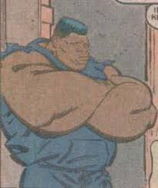


Search . . .
Brute
force
(Nested loops Approach)
12
#INCLUDE4.0

Slide 17
Search . . .
1 | 15 | -3 | 7 | 9 | -5 | 10 | 12
SUM = 1 + 15 + (-3) = 13
Maximum Sum = 13
13
#INCLUDE4.0

Slide 18
Search . . .
1 | 15 | -3 | 7 | 9 | -5 | 10 | 12
SUM = 1 + 15 + (-3) = 13
Maximum Sum = 13
1 | 15 | -3 | 7 | 9 | -5 | 10 | 12
SUM = 15 + (-3) + 7 = 19
Maximum Sum = 19
14
#INCLUDE4.0

Slide 19
Search . . .
1 | 15 | -3 | 7 | 9 | -5 | 10 | 12
SUM = (-3) + 7 + 9 = 13
Maximum Sum = 19
15

Slide 20
Search . . .
1 | 15 | -3 | 7 | 9 | -5 | 10 | 12
SUM = (-3) + 7 + 9 = 13
Maximum Sum = 19
1 | 15 | -3 | 7 | 9 | -5 | 10 | 12
SUM = 7 + 9 + (-5) = 11
Maximum Sum = 19
16

Slide 21
Search . . .
1 | 15 | -3 | 7 | 9 | -5 | 10 | 12
SUM = 9 + (-5) + 10 = 14
Maximum Sum = 19
17

Slide 22
Search . . .
1 | 15 | -3 | 7 | 9 | -5 | 10 | 12
SUM = 9 + (-5) + 10 = 14
Maximum Sum = 19
1 | 15 | -3 | 7 | 9 | -5 | 10 | 12
SUM = (-5) + 10 +12 = 17
Maximum Sum = 19
18

Slide 23
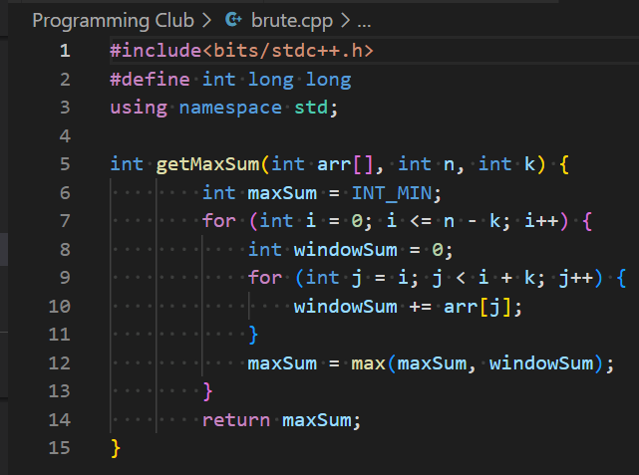
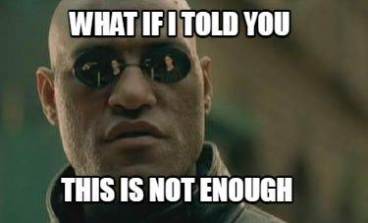
Code snippet
Search . . .
answer- 19
19

Slide 24

Search . . .
Time
Complexity
O(n*k)
19

Slide 25
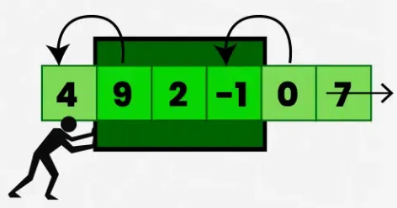
Sliding
Window
Search . . .
(Optimized Approach)
20

Slide 26
Search . . .
1 | 15 | -3 | 7 | 9 | -5 | 10 | 12
SUM = 1 + 15 + (-3) = 13
Maximum Sum = 13
21

Slide 27
Search . . .
1 | 15 | -3 | 7 | 9 | -5 | 10 | 12
SUM = 1 + 15 + (-3) = 13
Maximum Sum = 13
1 | 15 | -3 | 7 | 9 | -5 | 10 | 12
SUM = 13 + 7 - 1 = 19
Maximum Sum = 19
22

Slide 28
Search . . .
1 | 15 | -3 | 7 | 9 | -5 | 10 | 12
SUM = 19 + 9 - 15 = 13
Maximum Sum = 19
23

Slide 29
Search . . .
1 | 15 | -3 | 7 | 9 | -5 | 10 | 12
SUM = 19 + 9 - 15 = 13
Maximum Sum = 19
1 | 15 | -3 | 7 | 9 | -5 | 10 | 12
SUM = 13 + (-5) - (-3) = 11
Maximum Sum = 19
24

Slide 30
Search . . .
1 | 15 | -3 | 7 | 9 | -5 | 10 | 12
SUM = 13 + 10 - 7 = 16
Maximum Sum = 19
25

Slide 31
Search . . .
1 | 15 | -3 | 7 | 9 | -5 | 10 | 12
SUM = 13 + 10 - 7 = 16
Maximum Sum = 19
1 | 15 | -3 | 7 | 9 | -5 | 10 | 12
SUM = 14 + 12 - 9 = 17
Maximum Sum = 19
26

Slide 32
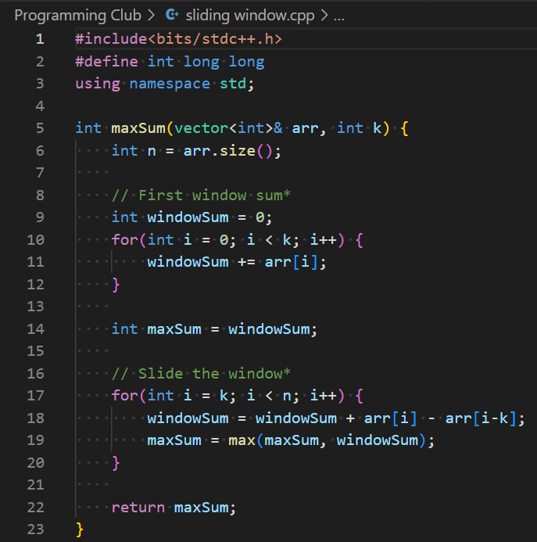

Search . . .
answer- 19
28

Slide 33

Search . . .
Time Complexity O(n)
29

Slide 34
Smallest Subarray
You are given an array of N integers and an integer K. Your task is to find the minimum sum of any contiguous subarray of size K.
https://bit.ly/4ifMhjE
27

Slide 35
STL

Slide 36
The Standard Template Library (STL) is a set of C++ template classes to provide common programming data structures and functions such as lists, stacks, arrays, etc. It is a library of container classes, algorithms, and iterators.
28

Slide 37
VECTOR

Slide 38
Vector
Vectors are same as dynamic arrays with the ability to resize itself automatically when an element is inserted or deleted, with their storage being handled automatically by the container.
29

Slide 39
int n;
cin>>n;
int a[n]; n=5
index
0
1
2
3
4
1 | 3 | 6 | 5 | 9
a[0]
a[1]
30

Slide 40
push_back( x )
pop_back()
size( )
emplace_back(x)
vector <int> v;
v.size()=4;
0 1 2 3 4
1 | 2 | 3 | 4
31

Slide 41
#include<bits/stdc++.h>
using namespace std;
int main()
{
vector<int> v;
int n;
cin >> n;
for(int i=0; i<n; i++)
{
v.push_back(i);
}
v.push_back(10);
for(int i=0; i<v.size(); i++)
{
cout<<v[i]<<" ";
}
cout<<endl;
v.pop_back( );
v.pop_back( );
int len=v.size( );
cout<<len<<endl;
for(int i=0; i<v.size(); i++)
{
cout<<v[i]<<" ";
}
return 0;
}
INPUT
5
Output
0 1 2 3 4 10
4
0 1 2 3
32

Slide 42
Reverse the Consonants
You are given a string s of size n (1 <= n <= 10^8). Your task is to reverse the consonants in the string.
https://bit.ly/42suLTn
56

Slide 43
PAIR

Slide 44
Pair
Coordinates (x,y) = { (6,7) , (12,10) , (4,9) , (16, 8) , (13,17) }
x ->
y ->
If we sort the coordinates , x[] and y[]
x ->
y ->
6 | 12 | 4 | 16 | 13
7 | 10 | 9 | 8 | 17
4 | 6 | 12 | 13 | 16
7 | 8 | 9 | 10 | 17
33

Slide 45
Pair is used to combine two values of 2 same or different data types together. To access the elements, we use variable name with dot operator followed by first or second.
pair<data_type,data_type> p;
pair<string,int> p[n]; //(array of pair)
34

Slide 46
#include<bits/stdc++.h>
using namespace std;
#define ll long long
int main() {
pair<ll,ll> p[5];
for(int i = 0 ; i < 5 ; i++) {
ll a,b;
cin >> a >> b;
p[i].first = a;
p[i].second = b;
}
sort(p,p+5);
for(int i = 0 ; i < 5 ; i++)
{
cout << p[i].first << " " << p[i].second;
cout << "\n";
}
return 0;
}
INPUT
1 2
6 5
4 6
3 8
5 10
OUTPUT
1 2
3 8
4 6
5 10
6 5
35

Slide 47
Iterators

Slide 48
Iterator
An iterator is any object that, pointing to some element in a range of elements (such as an array or a container), has the ability to iterate through the elements of that range using a set of operators (with at least the increment (++) and dereference (*) operators).
36

Slide 49
0 1 2 3
2
15
10
7
v.begin( )
v.begin( ) + 2
37

Slide 50
begin( )
end( )
rbegin()
rend()
int v[4] = {2, 15, 10, 7}
0 1 2 3
2
15
10
7
v.rend( )
v.begin( )
v.rbegin( )
v.end( )
38

Slide 51
for(auto it = v.begin(); it != v.end(); it++)
0 1 2 3
2
15
10
7
it
it
it
it
v.end()
39

Slide 52
SET

Slide 53
Sets are a type of containers in which each element has to be unique because the value of the element identifies it. The values are stored in a specific order.
Properties:
No duplicates
Sorted in ascending order.
Searches an element in O(log n) time.
Unindexed.
We can compromise with the sorted order for improving the search time, by using unordered set, which has search time of O(1).
40

Slide 54
Sets are declared as
set<int> st;
Where st is the name of the set and
int is the data type of the set.
st.insert(x);
Inserts the value x into the set if not already present.
Time Complexity : O(log(n)).
st.find(x);
Returns pointer to x if it is present else it points to the end of set.
Time Complexity : O(log(n)).
41

Slide 55
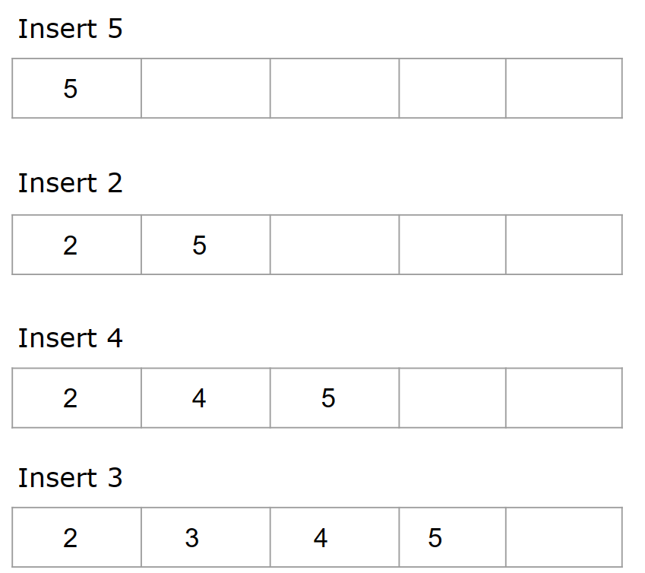
Example
#include<bits/stdc++.h>
using namespace std;
int main()
{
set < int > s;
s.insert( 5 ) ;
s.insert( 2 ) ;
s.insert( 4 ) ;
s.insert( 3 ) ;
for(auto it=s.begin();it!=s.end();it++)
cout<<*it<<” ”;
return 0; }
Output
2 3 4 5
42

Slide 56
#include<bits/stdc++.h>
using namespace std;
int main()
{
set < int > s;
s.insert( 60 ) ;
s.insert( 10 ) ;
s.insert( 20 ) ;
s.insert( 20 ) ;
s.insert( 40 ) ;
s.erase(10);
if( s.find(40)==s.end())
cout<<”40 not found.”;
else
cout<<”40 found.”;
cout<<endl;
if(s.find(10)==s.end())
cout<<”10 not found.”;
else
cout<<”10 found.”;
return 0;
}
Output
40 found.
10 not found.
43

Slide 57
Unordered Sets are declared as
unordered_set<int> ust;
Where ust is the name of the unordered set and int is the data type of the unordered set.
ust.insert(x);
Inserts the value x into the set if not already present.
Time Complexity of insert : O(1) or O(n) ??
ust.find(x);
Returns pointer to x if it is present else it points to the end of set.
Time Complexity of find : O(1) or O(n) ??
44

Slide 58
Unique Streak
Given a string 𝑆 , remove all duplicate characters while keeping only the first occurrence of each character.
https://bit.ly/3GiELXW
45

Slide 59
MAP

Slide 60
MAP
Maps are part of the C++ STL (Standard Template Library). Maps are the associative containers that store sorted key-value pair, in which each key is unique and it can be inserted or deleted but cannot be altered. Values associated with keys can be changed.
46

Slide 61
Example
Roll no -----> Student’s Name
(key) (Value)
(Index)
A
B
unique
Key
Value
0
24
45
46
47
54
Hema
Rekha
Jaya
Sushma
Nirma
24 | Hema
45 | Rekha
46 | Jaya
47 | Sushma
54 | Nirma
1
2
3
4
47

Slide 62
Map Declaration
Map is declared as map<int,int> mp;
where mp is the name of the map.
Insertion in Map
mp[key] = value;
This inserts the key ,value pair into the map in O(log(n)) time complexity in sorted order.
Printing Value from Key in Map
cout<<mp[key];
48

Slide 63
#include<bits/stdc++.h>
using namespace std;
#define ll long long
int main()
{
map<int,int> m;
int a[6]={1,3,2,1,2,1};
for(int i=0; i<6; i++)
{
m[a[i]]++;
}
cout << "Element Frequency";
cout << endl;
for (auto i : m)
{
cout << i.first << "\t\t\t" <<i.second;
cout<< endl;
}
return 0;
}
Output
Element Frequency
1 3
2 2
3 1
49

Slide 64
Unordered Map
Unordered Map are containers that stores key-value pairs in non-sorted order.
Unordered Map is declared as unordered_map<int, int> ump;
Where ump is the name of the unordered map.
Insertion in unordered Map
ump[key] = value; //Insertion time complexity=O(1)
Printing Value from Key in Map
cout<<ump[key];
50

Slide 65
STACK

Slide 66
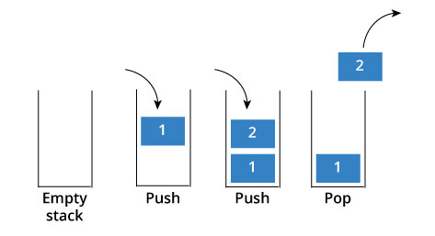
Stack
Stack is a linear data structure which follows a particular order in which the operations are performed. The order may be LIFO(Last In First Out) or FILO(First In Last Out).
There are many real-life examples of a stack. Consider an example of plates stacked over one another in the canteen.
51

Slide 67
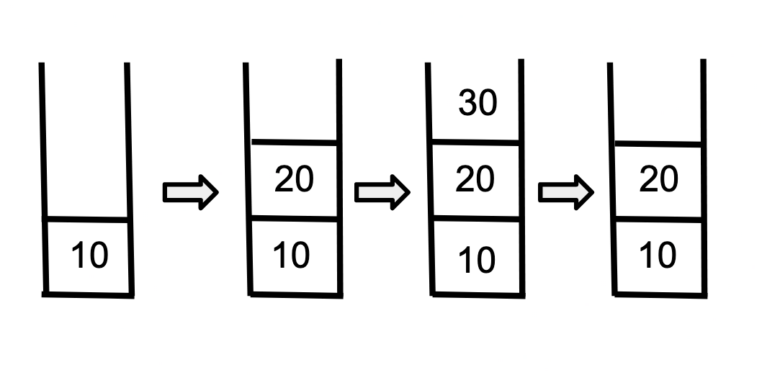

#include<bits/stdc++.h>
using namespace std;
int main()
{
stack<int> s;
s.push(10);
s.push(20);
s.push(30);
s.pop();
return 0;
}
30
20
20
20
10
10
10
10
52

Slide 68
QUEUE

Slide 69
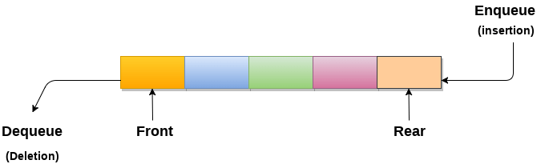
Queue
Queue is a data structure designed to operate in FIFO (First in First out) context. In queue elements are inserted from rear end and get removed from front end.
53

Slide 70
#include<bits/stdc++.h>
using namespace std;
int main()
{
queue<int> q;
q.push(10);
q.push(5);
q.push(15);
q.pop();
return 0;
}
10
10
5
10 5 15
5 15
54

Slide 71
PRIORITY QUEUE

Slide 72
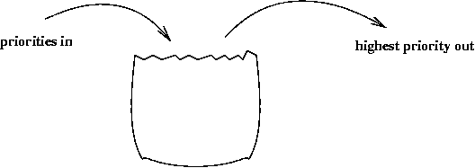
Priority queue is a container which is designed such that the first element of the queue is greatest of all the elements and the elements are in descending order.
Declaration - priority_queue<int> q;
55

Slide 73
#include<bits/stdc++.h>
using namespace std;
int main()
{
priority_queue<int> pq;
pq.push(10);
pq.push(5);
pq.push(15);
pq.pop();
return 0;
}
10
10
5
15 10 5
10 5
56

Slide 74
SEARCHING

Slide 75
Linear Search
Linear Search is defined as sequential search algorithm that starts at one end and goes through each element of data set until the desired element is found, otherwise the search continues till the end of the data set.
57

Slide 76
To find element 24
2 | 7 | 19 | 22 | 24
2 | 7 | 19 | 22 | 24
2 | 7 | 19 | 22 | 24
2 | 7 | 19 | 22 | 24
2 | 7 | 19 | 22 | 24
58

Slide 77
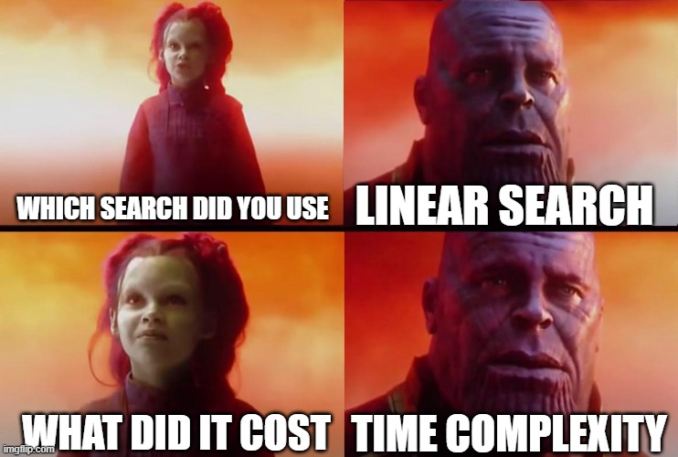
59

Slide 78
Binary Search
Binary Search can be defined as a searching algorithm used in sorted array by repeatedly dividing the search space in halves. It reduces the time complexity to O(log N).
60

Slide 79
To find element 24
2 | 5 | 7 | 9 | 12 | 13 | 16 | 19 | 22 | 24 | 34 | 45
2 | 5 | 7 | 9 | 12 | 13 | 16 | 19 | 22 | 24 | 34 | 45
2 | 5 | 7 | 9 | 12 | 13 | 16 | 19 | 22 | 24 | 34 | 45
2 | 5 | 7 | 9 | 12 | 13 | 16 | 19 | 22 | 24 | 34 | 45
Element is found at index 9
https://ideone.com/1f5ocT
61

Slide 80

62

Slide 81

Complexity of Binary Search
63

Slide 82
N / 2^0 = 8
N / 2^1 = 4
N / 2^2 = 2
N / 2^k = 1
64

Slide 83
So, In worst case we take K steps to reduce array size to 1
N / 2^{k}= 1
N = 2^{k}
log₂(N) = log₂(2^{k})
log₂(N) = k
65

Slide 84
lower_bound
lower_bound() returns an iterator pointing to the first element which is greater than or equal to the value. If no such element is found, it returns address of the very last element.
Syntax : lower_bound(start, end, key);
Returns : address
67

Slide 85
upper_bound
upper_bound() returns an iterator pointing to the first element which is greater than the value. If no such element is found, it returns address of the very last element.
Syntax : upper_bound(start, end, key);
Returns : address
68

Slide 86
Iterator pointing to which index will be returned?
arr = {1, 2, 3, 3, 3, 6, 7}
Answers
2
5
6
lower_bound(arr, arr+6, 3)
lower_bound(arr, arr+6, 4)
lower_bound(arr, arr+6, 10)
upper_bound(arr, arr+6, 3)
upper_bound(arr, arr+6, 4)
upper_bound(arr, arr+6, 10)
Answers
5
5
6
69

Slide 87
Find the book
You are given a sorted list of book prices in non-decreasing order and Q customer queries. Each query consists of a price K, and you need to determine:
https://bit.ly/4crTonS
70

Slide 88
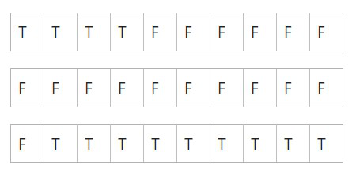
vPredicate Binary Search
Rather than searching on elements we try to search on boolean values.
A predicate function is a function that take input and return a single output TRUE or FALSE.
71

Slide 89
Template for Predicate Binary Search
int main(){
int low; // lower bound
int high; // upper bound int ans = 1e9;
while(low <= high){
int mid = (low + high)/2;
if(check(mid)) {
ans = mid;
low = mid + 1;
else {
high = mid - 1; }
}
return ans;
}
bool check(int num){
/*This function will return
true or false depending
if num fulfills the required
condition*/
}
72

Slide 90
Koko Eating Bananas
Koko loves to eat bananas. There are n piles of bananas, the i-th pile has piles[i] bananas. The guards have gone and will come back in h hours.
Koko can decide her bananas-per-hour eating speed of k. Each hour, she chooses some pile of bananas and eats k bananas from that pile. If the pile has less than k bananas, she eats all of them instead and will not eat any more bananas during this hour.
Koko eating bananas
73

Slide 91


Feedback Form
Feedback Form
bit.ly/4j9PxhX
74

